Slide 1


CHATBOT DEPLOYMENT ON IBM CLOUD
WATSON ASSISTANT

Slide 2

TEAM MEMBERS :
SATHISHKUMAR M
MANOJPRABAKARAN S
DURAISAMY S
LAKSHMANRAJ S
YOSHUA U
SELVAMURGAN P

Slide 3
INTRODUCTION:
The project focuses on developing a customer support chatbot using Watson Assistant to improve user interactions, reduce customer support workload, and enhance user satisfaction. In this project, we will outline the project's objective, the design thinking process, development phases, describe the chatbot's persona, conversation flow, and technical implementation, and provide examples of user queries and chatbot responses.

Slide 4
PROJECT OBJECTIVE:
The project's primary objective is to create an AI-powered customer support chatbot that enhances user interactions, reduces the workload on human support agents, and improves overall customer satisfaction.

Slide 5
DESIGN THINKING PROCESS:
1.Empathize:
Understand user needs and support challenges, gather feedback, and identify common pain points in customer interactions.
2.Define:
Define the chatbot's scope, objectives, and KPIs, including the types of questions it will handle and its integration with existing support processes.

Slide 6
3.Ideate:
Brainstorm the chatbot's features, persona, and conversation flow to create an engaging and informative user experience.
4.Prototype:
Create a prototype of the chatbot's conversation flow and test it with sample user queries to refine the design.

Slide 7
5.Test:
Gather feedback from potential users, iterate on the design, and enhance the chatbot's functionality.
DEVELOPMENT PHASES:
1.Persona Design:
Create a friendly and professional chatbot persona, such as "SupportBot," to align with the brand and build user trust.

Slide 8
2.Conversation Flow Design:
Plan the chatbot's conversation flow, including greetings, handling common queries, and transferring to human agents when necessary.
The conversation flow for the Facebook Messenger chatbot should be designed to accommodate text-based interactions and, where relevant, multimedia elements like images, videos, or quick reply buttons.

Slide 9
3.Technical Implementation:
a.Watson Assistant Setup: Configure Watson Assistant to understand and respond to user queries through Facebook Messenger.
b.Integration: Set up integration with Facebook Messenger, ensuring the chatbot can communicate on the platform.

Slide 10
c.Natural Language Understanding: Train the chatbot using sample Messenger-based queries to improve its understanding and responses.
d.Testing and Training: Continuously test the chatbot within the Messenger environment, optimizing its performance for this specific platform.

Slide 11
4.Deployment:
Deploy the chatbot on Facebook Messenger and ensure it's accessible to users.
5.Monitoring and Maintenance:
Regularly monitor the chatbot's performance on Messenger, collect user feedback, and make updates to maintain optimal functionality and user satisfaction.

Slide 12
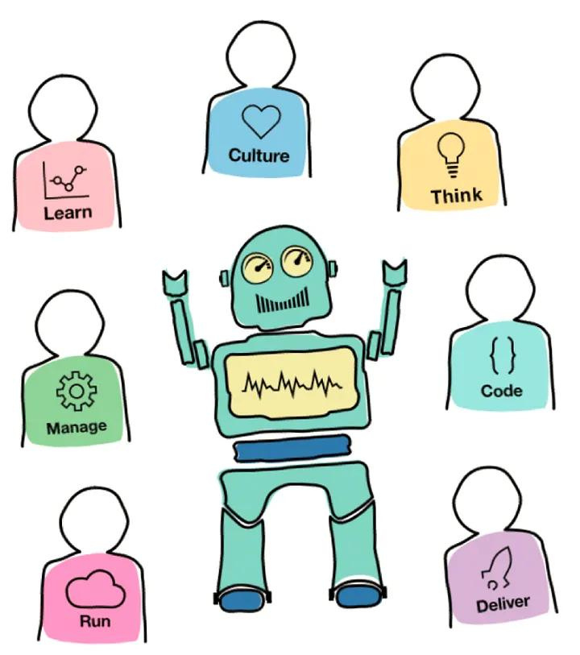
IBM Watson Assistant meet IBM Enterprise Design Thinking

Slide 13
EXAMPLES OF USER QUERIES AND CHATBOT RESPONSES FOR FACEBOOK MESSENGER:
1.User Query: "How can I reset my password?"
Chatbot Response: "To reset your password, please type 'Reset password' and I'll guide you through the process step by step."

Slide 14
2.User Query: "Can you check the status of my recent order?"
Chatbot Response: "Sure, please provide your order number, and I'll check the status for you."
3.User Query: "Tell me about your new products."
Chatbot Response: "We have some exciting new products! To see the latest offerings, type 'New products' and I'll share details with you."

Slide 15
4.User Query: "What are your customer support hours on Messenger?"
Chatbot Response: "Our Messenger support is available 24/7. Feel free to ask any questions, and we'll assist you as quickly as possible."

Slide 16
Conclusion:
the development of a customer support chatbot using Watson Assistant follows a systematic approach, from understanding user needs to technical implementation and ongoing maintenance. A well-designed chatbot persona, effective conversation flow, and continuous training and testing are critical to achieving the project's objectives and delivering an enhanced customer support experience.

